Slide 1

Letter of intent or Term sheet
Confidential
Created by Consultants previously from Deloitte, McKinsey & BCG

Slide 2
What is a Letter of Intent (LOI) in M&A?
The Letter of Intent or Term Sheet in M&A is a written, non-binding document which outlines an agreement in principle for the buyer to purchase the seller's business, stating the proposed price and terms. The mutually signed LOI is required before the buyer proceeds with the “due diligence” phase of acquisition. Besides detailing the price and payment terms of the transaction, the LOI includes items such as description of the assets to be purchased, any assumed liabilities, the terms of the seller’s non-compete agreement, the timeline for due diligence and closing, a confidentiality provision, and an exclusivity provision, commonly referred to as a “no shop clause.”

Slide 3
There are 2 main reasons to enter into an LOI
Saving time and money by negotiating and putting in writing all the important terms of the transaction while minimizing misunderstandings and conflicts later in the process. Without having a basic understanding of all the terms of the transaction in an LOI, drafting a detailed purchase agreement can be lengthy and difficult. LOIs usually are 6-8 pages in length whereas a purchase agreement is generally much longer.
An experienced buyer will not spend considerable time and money proceeding into due diligence, analyzing all the information on the company, engaging CPA’s for tax advice and attorneys for drafting purchase documents unless they have an exclusive right to buy the company.

Slide 4
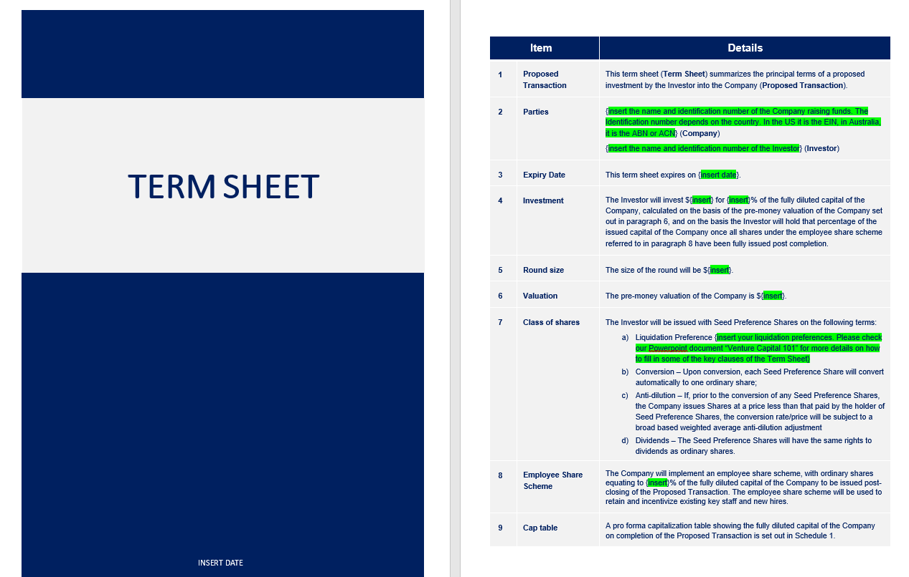
Term sheet example
For more details, open the word document “Term Sheet Template between Investor & Startup”

Slide 5
Thanks for your attention!
www.domontconsulting.com

